Slide 1
IMAGE RECOGNITION SYSTEM
SUBMITTED BY: SUBMITTED TO:
NAVEEN ARYA DR. RAMESH KUMAR KAIT
MCA(FINAL) DCSA(KUK)
U.R.NO.:8100457
ROLL NO.:130

Slide 2
IMAGE RECOGNITION SYSTEM
INTRODUCTION TO PROJECT
MACHIN LEARNING TYPE
WIRKING OF PROJECT
SYSTEM REQUIRMENTS
FUTURE SCOPE

Slide 3
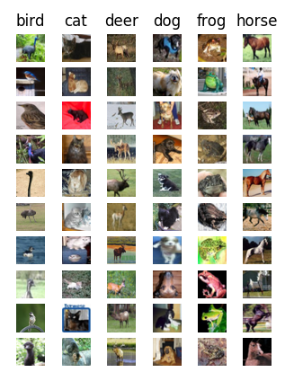
INTRODUCTION TO PROJECT
In the project of basic Image recognition project the model was already created. But in this project model should be created by user on the bases of requirement.
Project is divided into three part:
1.Create Model:
Using dataset a model is required to create.
2.Use Model:
Using an image model can predict the class of image.
3.Delete Model:
There should be an potion to delete the model for memory utilization.

Slide 4

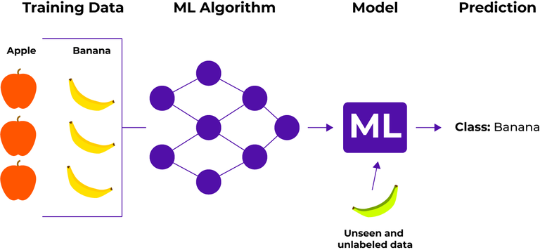
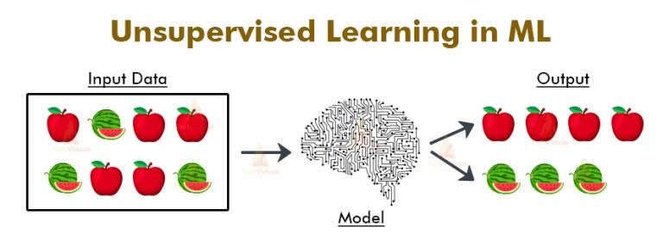
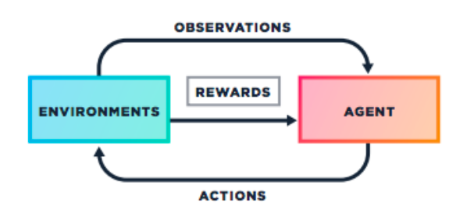
Machin learning types
1.Supervised Learning
2.Unsupervised Learning
3.Reinforcement Learning
Supervised Learning is a method in which the machine is trained on labeled data with guidance.
Unsupervised Learning the machine is trained on unlabeled data without any guidance.
Reinforcement Learning an agent interacts with its environment by production action and discovers errors or rewards.

Slide 5
Working of Project
Creating Model
Using Model
INPUT DATASET
READ IMAGE IN THE FORM OF NUMPY MATRIX
READ LABLE IN THE FORM OF LIST
SPLIT AND TRAIN MODEL
SPLIT DATASET INTO TRAIN AND TAST DATASET
TRAIN MODEL USING TRAIN DATASET
TEST AND SAVE MODEL
TEST MODEL USING TEST DATASET
SAVE MODEL USING PICKLE LIBRARY
INPUT IMAGE AND MODEL
CANVERT IMAGE INTO NUMPY MATRIX
GET LABEL
USING INPUT IMAGE IN MODEL
MODEL RETURN IMAGE LABEL
LOAD MODEL FROM MODEL LIST

Slide 6
System requirement
HARDWARE REQUIREMENT:
Processor- with Speed min-2.2GHz
512GB SSD
GPU(12GB VRAM)
SOFTWARE REQUIREMENT:
Anaconda 2018.12
Libraries: sklearn, numpy, pickle
Windows 10, Red Hat Linux 7.6

Slide 7
Future scope
Boosting Driverless Car Technology
Giving Machines a Vision
Claver thief chasing/Intention of person

Slide 8
THE END

